Slide 1


Salient Object Detection Using a Custom CNN
Jon Ibrani
© 2025 Copyright Genpact. All Rights Reserved.

Slide 2
Data Preprocessing & Augmentation
Dataset: DUTS (10,000 image–mask pairs)
Images resized to 128×128 and normalized to [0–1]
Masks binarized and formatted as single-channel
Split: 70% Train, 15% Validation, 15% Test
Augmentation techniques:
Horizontal flip
Random crop and resize
Brightness variation
Added After Baseline
Vertical Flip
Contrast Adjustment
Saturation Adjustment

Slide 3
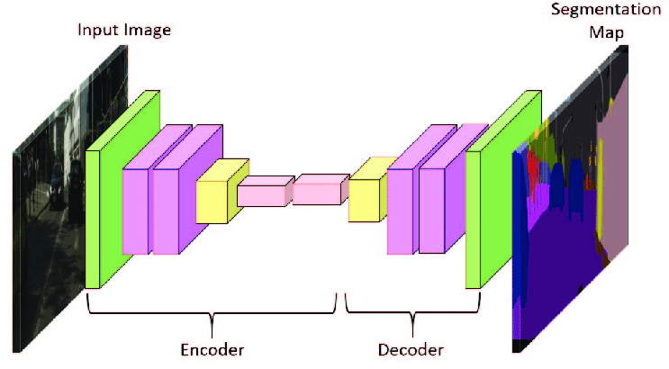
Baseline
Architecture: Basic Encoder–Decoder CNN
• Encoder: 3 Conv2D layers (32, 64, 128) + MaxPooling
• Decoder: 3 Conv2DTranspose layers for upsampling
• Final layer: 1×1 Conv2D with sigmoid activation
• No skip connections
Loss: Binary Cross-Entropy + 0.5 × (1 – IoU)

Slide 4
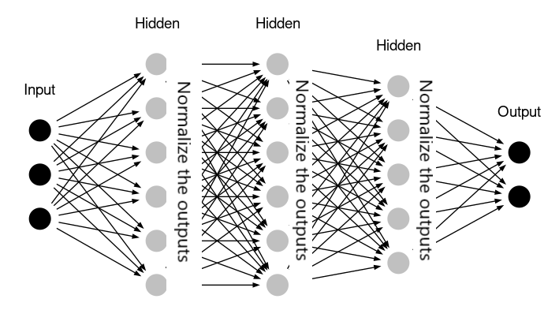
Model Improvements
Enhancements to baseline architecture
Batch Normalization after each encoder block
Increased encoder depth: 2 Conv2D layers per block
Increased augmentation techniques

Slide 5
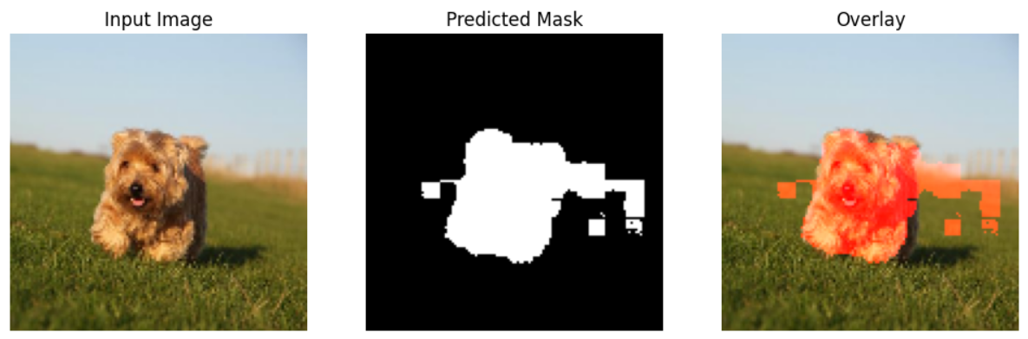
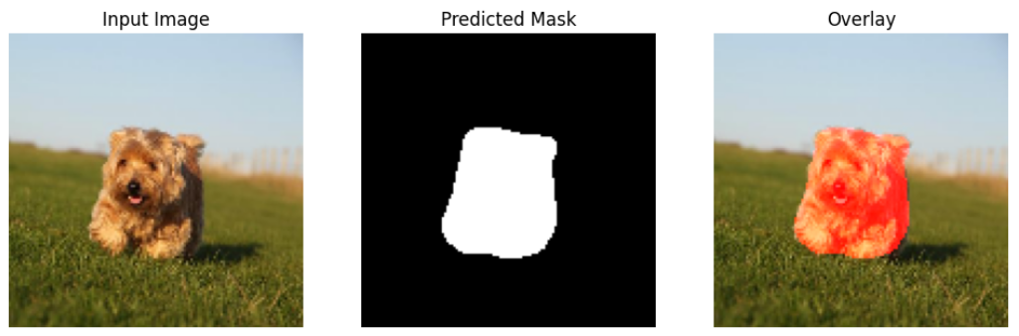
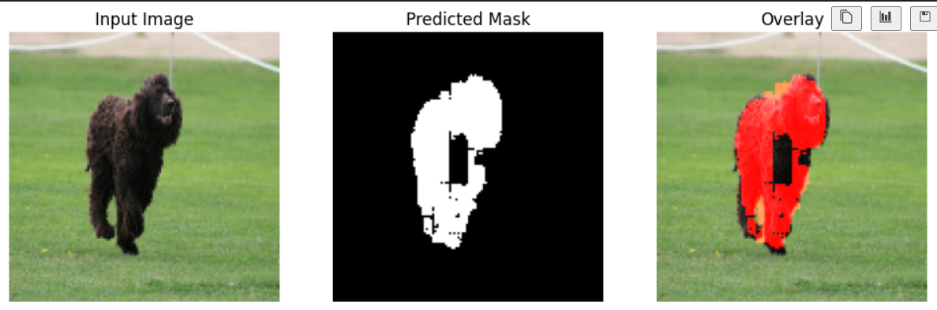
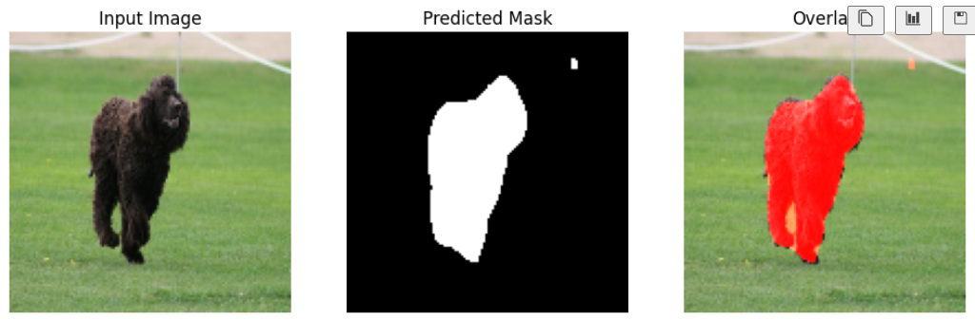
Comparisons
Baseline Model Metrics Precision: 0.6623 Recall: 0.6291 F1 Score: 0.6418 IoU (Intersection over Union): 0.4756 Mean Absolute Error: 0.1881
Final Model Metrics Precision: 0.8083 Recall: 0.8332 F1 Score: 0.8188 IoU (Intersection over Union): 0.6950 Mean Absolute Error: 0.1017

